Slide 1
This project is one of the T5 Data Science BootCamp Nadia hjrasi

Slide 2

Individual Company customer Data

Slide 3
Goal of the project
Customer data analysis is a detailed analysis of a company's ideal customers. It helps businesses better understand their customers and makes it easier for them to modify products according to the specific needs, behaviors, and interests of different types of customers.
Customer data analysis helps the company to identify the types of target groups in terms of age, gender, residence, country,... etc. and to adjust its products based on its target customers from different types of customer segments. For example, instead of spending money to market a new product to each customer in the company's database, the company can analyze which customer segment is likely to buy the product and then market the product to only that specific segment

Slide 4
The dataset is provided in .csv ,and dataset includes about 40,000 rows and 15 columns

Slide 5
Steps of the project as follows: 1-Load Dataset 2-Explore Dataset 3-Cleaning Dataset 4-Analysis and Visualization

Slide 6
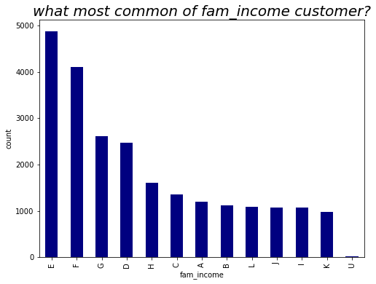
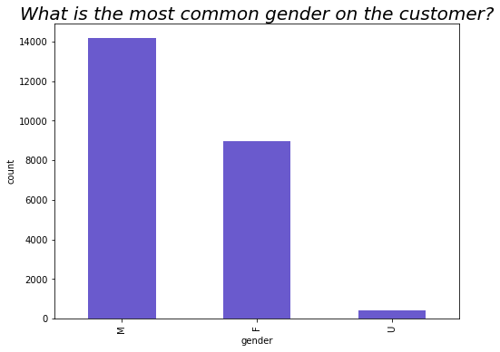
summary of analysis and Visualization

Slide 7
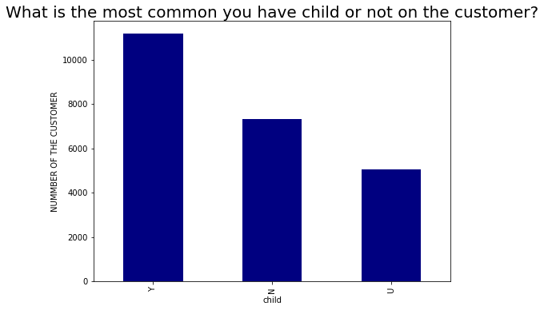
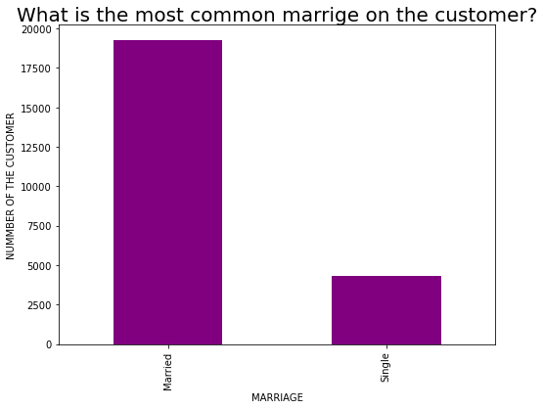

Slide 8
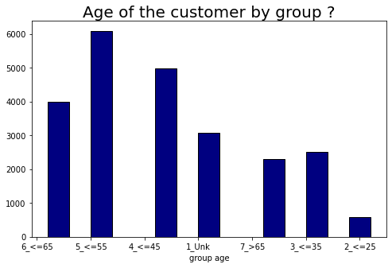
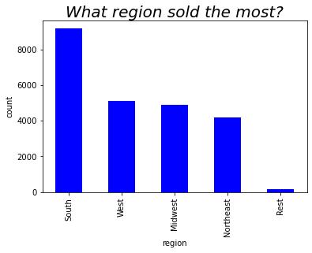

Slide 9
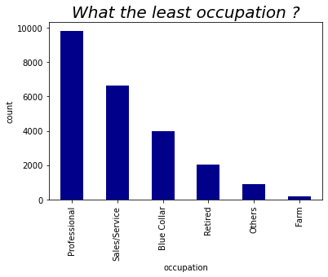
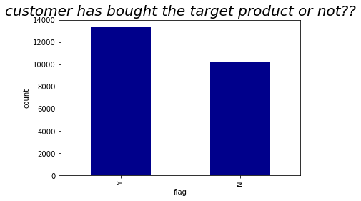

Slide 10
